Slide 1


Strings in PHP
Working with Text in PHP Strings and String Functions
Mario Peshev
Technical Trainer
http://peshev.net
Software University
http://softuni.bg

Slide 2

Table of Contents
What Are Strings?
Manipulating Strings
Built-in String Functions
Regular Expressions

Slide 3
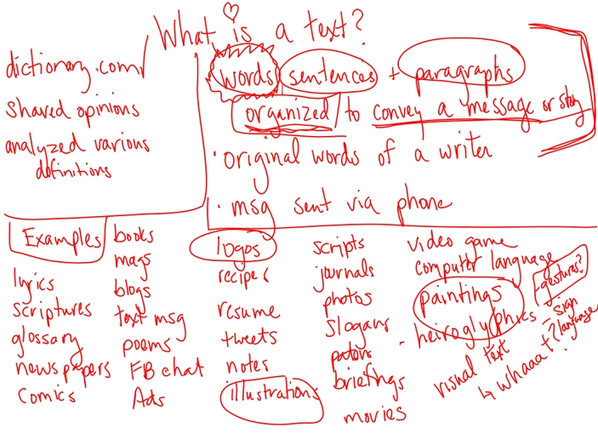
What Are Strings?

Slide 4
What Are Strings?
Text string:
Contains zero or more characters surrounded by double or single quotation marks
Can be used as literal values or assigned to a variable
Can also be surrounded with single quotation marks
<?php
echo '<p>Mr. Svetlin Nakov</p>';
$workPlace = "<span>Software University</span>";
echo $workPlace;
?>

Slide 5
What Are Strings? {2}
Single quotes are escaped when used in double quoted strings
Double quotes are escaped when used in single quoted strings
<?php
echo "<p>I'm a Software Developer</p>";
?>
<?php
echo '<span>At "Software University"</span>';
?>

Slide 6

Manipulating Strings

Slide 7
String Operators
In PHP, you use two operators to combine Strings
Concatenation Operator “.”
Concatenation assignment operator “.=”
<?php
$homeTown = "Madan";
$currentTown = "Sofia";
$homeTownDescription = "My home town is" . $homeTown;
$homeTownDescription .= "But now I am in " . $currentTown;
echo $homeTownDescription;
?>

Slide 8
Escape Characters
Added before a special purpose character follows it has a special purpose
In PHP, the escape character is the backslash \
<?php
$myCourse = 'I\'m a PHP Developer';
?>

Slide 9
Escape Sequence
The escape character combined with one or more other characters is called an escape sequence
Escape Sequence | Description
\\ | Insert a backslash
\$ | Insert a dollar sign
\r | Insert a carriage return
\” | Escape a double quotation mark
\t | Insert a horizontal tab
\n | Insert a new line

Slide 10
Simple and Complex String
Simple string syntax uses the value of a variable within a string by including the variable name inside a text string with double quotation marks
When variables are placed within curly braces inside of a string, it is called complex string syntax
<?php
$popularName = "Pesho";
echo "Hello $popularName";
?>
<?php
$popularName = "Pesho";
echo "Hello {$popularName}";
?>

Slide 11

Simple and Complex String{2}
When variables are placed within curly braces inside of a string, it is called complex string syntax
<?php
$popularName = "Pesho";
echo "Hello {$popularName}";
?>

Slide 12

Manipulating Strings
Live Demo

Slide 13

Built-in String Functions

Slide 14
Counting Characters
The most commonly used string counting function is the strlen() function
returns the total number of characters in a string
<?php
$name = "Software University";
echo strlen($name);
?>
Output : 11

Slide 15
Counting Words
The str_word_count() function returns the number of words in a string
Pass the str_word_count() function a literal string or the name of a string variable whose words you want to count
String contains 5 countries.
<?php
$countries = "Bulgaria, Brazil, Italy, USA, Germany";
echo "<p>String contains " . str_word_count($countries). " countries.</p>";
?>

Slide 16

Counting Strings
Live Demo

Slide 17
Finding Characters and Substrings
There are two types of string search and extraction functions:
Functions that return a numeric position in a text string
strpos() - Performs a case-sensitive search and returns the position of the first occurrence of one string in another string
<?php
$countries = "Brazil, Italy, Bulgaria, USA, Germany";
$bulgaria = "Bulgaria";
echo "Position of Bulgaria is: " . strpos($countries, $bulgaria);
?>
Position of Bulgaria is: 15

Slide 18
Extracting Characters and Substrings
Functions that return a character or substring
strstr() - Function starts searching at the beginning of a string
strstr($input, $search, true) - Function starts searching at the end of a string
Both functions return a substring from the specified characters to the end of the string
String from Bulgaria to End: Bulgaria, USA, Germany
<?php
$countries = "Brazil, Italy, Bulgaria, USA, Germany";
$bulgaria = "Bulgaria";
echo "String from Bulgaria to end: " . strstr($countries, $bulgaria);
?>

Slide 19
Extracting Characters and Substrings{2}
substr() - To extract characters from the beginning or middle of a string
You pass to the substr() function a text string along with the starting and ending positions of the substring you want to extract
<?php
$email = "nakov@example.com";
$nameEnd = strpos($email, "@");
echo "The name portion of the e-mail address is: " . substr($email, 0,$nameEnd);
?>
The name portion of the e-mail address is: nakov

Slide 20

Finding And Extracting
Live Demo

Slide 21
String Replacing
The str_replace() and str_ireplace() functions both accept three arguments:
The string you want to search for
A replacement string
The string in which you want to replace characters
<?php
$email = "bignakov@example.com";
$newEmail = str_replace("bignakov", "juniornakov", $email);
echo $newEmail;
?>
juniornakov@example.com

Slide 22
Trim
Trim - Strip whitespace (or other characters) from the beginning and end of a string
This function returns a string with whitespace stripped from the beginning and end of $boo.
Also have:
ltrim() – trim from beginning of a string
rtrin() – trim from end of a string
<?php
$boo = " foo ";
echo "After trim " trim($boo);
?>
After trim “foo”

Slide 23
Case Changing
strtolower() - Make a string lowercase
strtoupper() - Make a string uppercase
<?php
$boo = "FOO";
echo strtolower($boo);
?>
foo
FOO
<?php
$boo = "foo";
echo strtoupper($boo);
?>

Slide 24
Converting String to Array
The str_split() function splits each character in a string into an array element
The length argument represents the number of characters you want assigned to each array element
The length argument represents the number of characters you want assigned to each array element
$array = str_split(string[, length]);

Slide 25
Converting String to Array{2}
The explode() function splits a string into an indexed array at a specified separator
<?php
$presidents = "Georgi Pyrvanov;Jelio Jelev;Petyr Stoqnov;Rosen Pleveneliev;";
$presidentAsArray = explode( ";“ , $presidents);
print_r( $presidentAsArray);
?>
Array
(
[0] => Georgi Pyrvanov
[1] => Jelio Jelev
[2] => Petyr Stoqnov
[3] => Rosen Pleveneliev
)

Slide 26
explode() Function
Does not separate a string at each character that is included in the separator argument
Evaluates the characters in the separator argument as a substring
If you pass to the explode() function an empty string as the separator argument, the function returns a value of false

Slide 27
Converting Array to String
Implode() - Combines an array’s elements into a single string, separated by specified characters
<?php
$presidents = ["Georgi Pyrvanov", "Jelio Jelev", "Petyr Stoqnov", "Rosen Pleveneliev"];
$presidentAsString = implode(";", $presidents);
echo $presidentAsString;
?>
Georgi Pyrvanov;Jelio Jelev;Petyr Stoqnov;Rosen Pleveneliev

Slide 28

String <> Array
Live Demo

Slide 29
String Comparison Functions
The strcasecmp() function performs a case-insensitive comparison of strings
The strcmp() function performs a case-sensitive comparison of strings
Both functions accept two arguments representing the strings you want to compare
Most string comparison functions compare strings based on their ASCII values

Slide 30
String Comparison Functions Example
<?php
$fName = "Nakov";
$fNameSmall = "nakov";
echo "Case insensitive\n";
echo strcasecmp($fName, $fNameSmall) . "\n";
echo "Case sensitive\n";
echo strcmp($fName, $fNameSmall);
?>
Case insensitive
0
Case sensitive
-1

Slide 31

More comparing functions
strnatcmp(), strncasecmp(), levenshtein(), metaphone(), similar_text(), soundex(), strnatcasecmp()

Slide 32

String Comparing
Live Demo

Slide 33
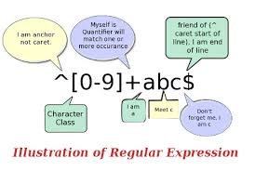
Regular Expressions

Slide 34
Regular Expressions
It is usually possible to use a combination of various built-in PHP functions to achieve what you want.
However, sometimes this gets complicated and we turn to Regular Expressions.
Regular expressions are a concise (but complicated!) way of pattern matching
Define a pattern used to validate or extract data from a string

Slide 35
Some definitions
Definition of the pattern (the ‘Regular Expression’):
'/^[a-z\d\._-]+@([a-z\d-]+\.)+[a-z]{2,6}$/i‘
PHP functions to do something with data and regular expression:
preg_match(), preg_replace()

Slide 36
Regex: Delimiters
The regex definition is always bracketed by delimiters, usually a ‘/’:
pattern: ’/php/’;
Matches: ‘php’, ‘I love php’, ‘phpphp’
Doesn’t match: ‘PHP’, ‘I love ph’

Slide 37
Regex: Character groups
A regex is matched character-by-character. You can specify multiple options for a character using square brackets:
$regex = ’/p[huo]p/’;
Matches: ‘php’, ’pup’, ‘pop’
Doesn’t match: ‘phup’, ‘ppp’, ‘pHp’

Slide 38
Regex: Predefined Classes
A regex is matched character-by-character. You can specify multiple options for a character using square brackets:
\d | Matches a single character that is a digit (0-9)
\s | Matches any whitespaces character (include tabs and line breaks)
\w | Matches any alphanumeric character (A-Z, 0-9) or underscore

Slide 39
Regex: the Dot
The special dot character matches any character except for a line break:
$regex = ’/p.p/’;
Matches: ‘php’, ’p&p’, ‘p(p’, ‘p3p’, ‘p$p’
Doesn’t match: ‘PHP’, ‘phhp’

Slide 40
Regex: Repetition
There are a number of special characters that indicate the character group may be repeated:
? | Zero or 1 times
* | Zero or more times
+ | 1 or more times
{a, b} | Between a and b times

Slide 41
Regex: Anchors
So far, we have matched anywhere within a string. We can change this behavior by using anchors:
^ | Start of the string
$ | End of string

Slide 42

Regular Expressions
Live Demo

Slide 43


Summary
All about simple strings
Manipulating Strings
Escaping, Operators
Built-in String Functions
Most popular functions in PHP
Regular Expressions
Regex Pattern
preg_match(), preg_replace()
PHP & MySQL

Slide 44
PHP & MySQL
https://softuni.bg/trainings/fasttracks/details/1033

Slide 45
License
This course (slides, examples, demos, videos, homework, etc.) is licensed under the "Creative Commons Attribution-NonCommercial-ShareAlike 4.0 International" license
Attribution: this work may contain portions from
"PHP Manual" by The PHP Group under CC-BY license
"PHP and MySQL Web Development" course by Telerik Academy under CC-BY-NC-SA license

Slide 46





Free Trainings @ Software University
Software University Foundation – softuni.org
Software University – High-Quality Education, Profession and Job for Software Developers
softuni.bg
Software University @ Facebook
facebook.com/SoftwareUniversity
Software University @ YouTube
youtube.com/SoftwareUniversity
Software University Forums – forum.softuni.bg

